Slide 1
2048
Shizhong Hao
Chiye Huang

Slide 2
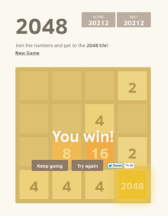
What’s 2048?
2048 is a sliding block game on a 4X4 grid.
Every turn, a new block with number 2 would appear.
Two block of same value will merge and add together when moving.
When there is a block with 2048, user will win the game.

Slide 3
States
Initial
Gen1
Move
Merge
Done
Gen2

Slide 4
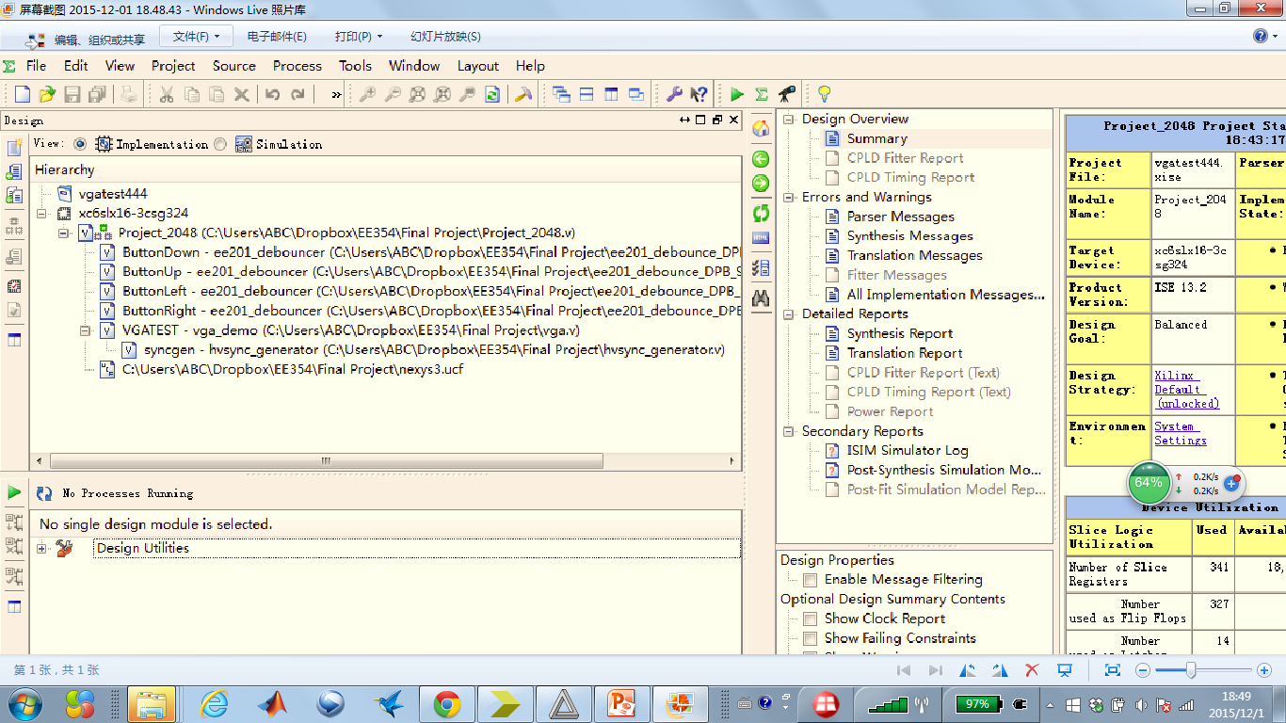
Module used

Slide 5
User Interface
MOVEMENT: UP,DOWN, LEFT,RIGHT (BTNU, BTND,BTNL,BTNR)
RESET (Sw0)
START (Sw1)
ACK(Sw2)

Slide 6
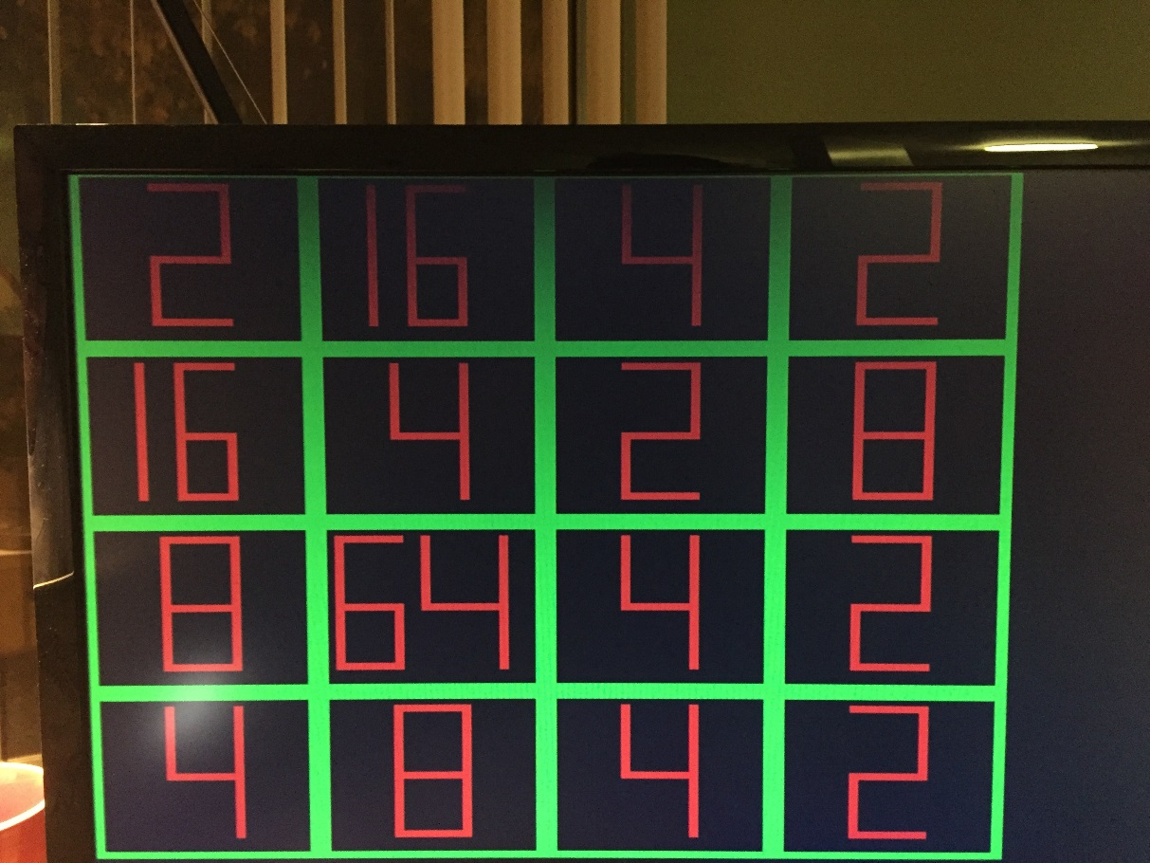
Display

Slide 7
Problems we encountered
Display
Flashing Numbers
Random color blocks
Algorithm
For loop in Verilog
Button malfunctioning
Array passing

Slide 8
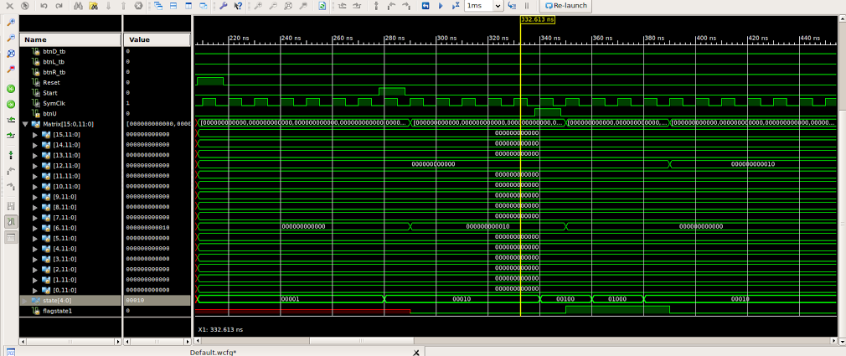
Test Methodology
Test bench
Actual display to see the game results

Slide 9
Resource Consumption
Number of Slice Registers: 341 out of 18224 1%
Number of Slice LUTs: 4668 out of 9112 51%
Number used as Logic: 4668 out of 9112 51%

